Slide 1
MOVIE RATINGS AND PERSONALITIES
MSBA TEAM D
Wei Chen Lee
Jessica Zhang
Hengjun Yang
Himangini Banwari
Mike Chung

Slide 2
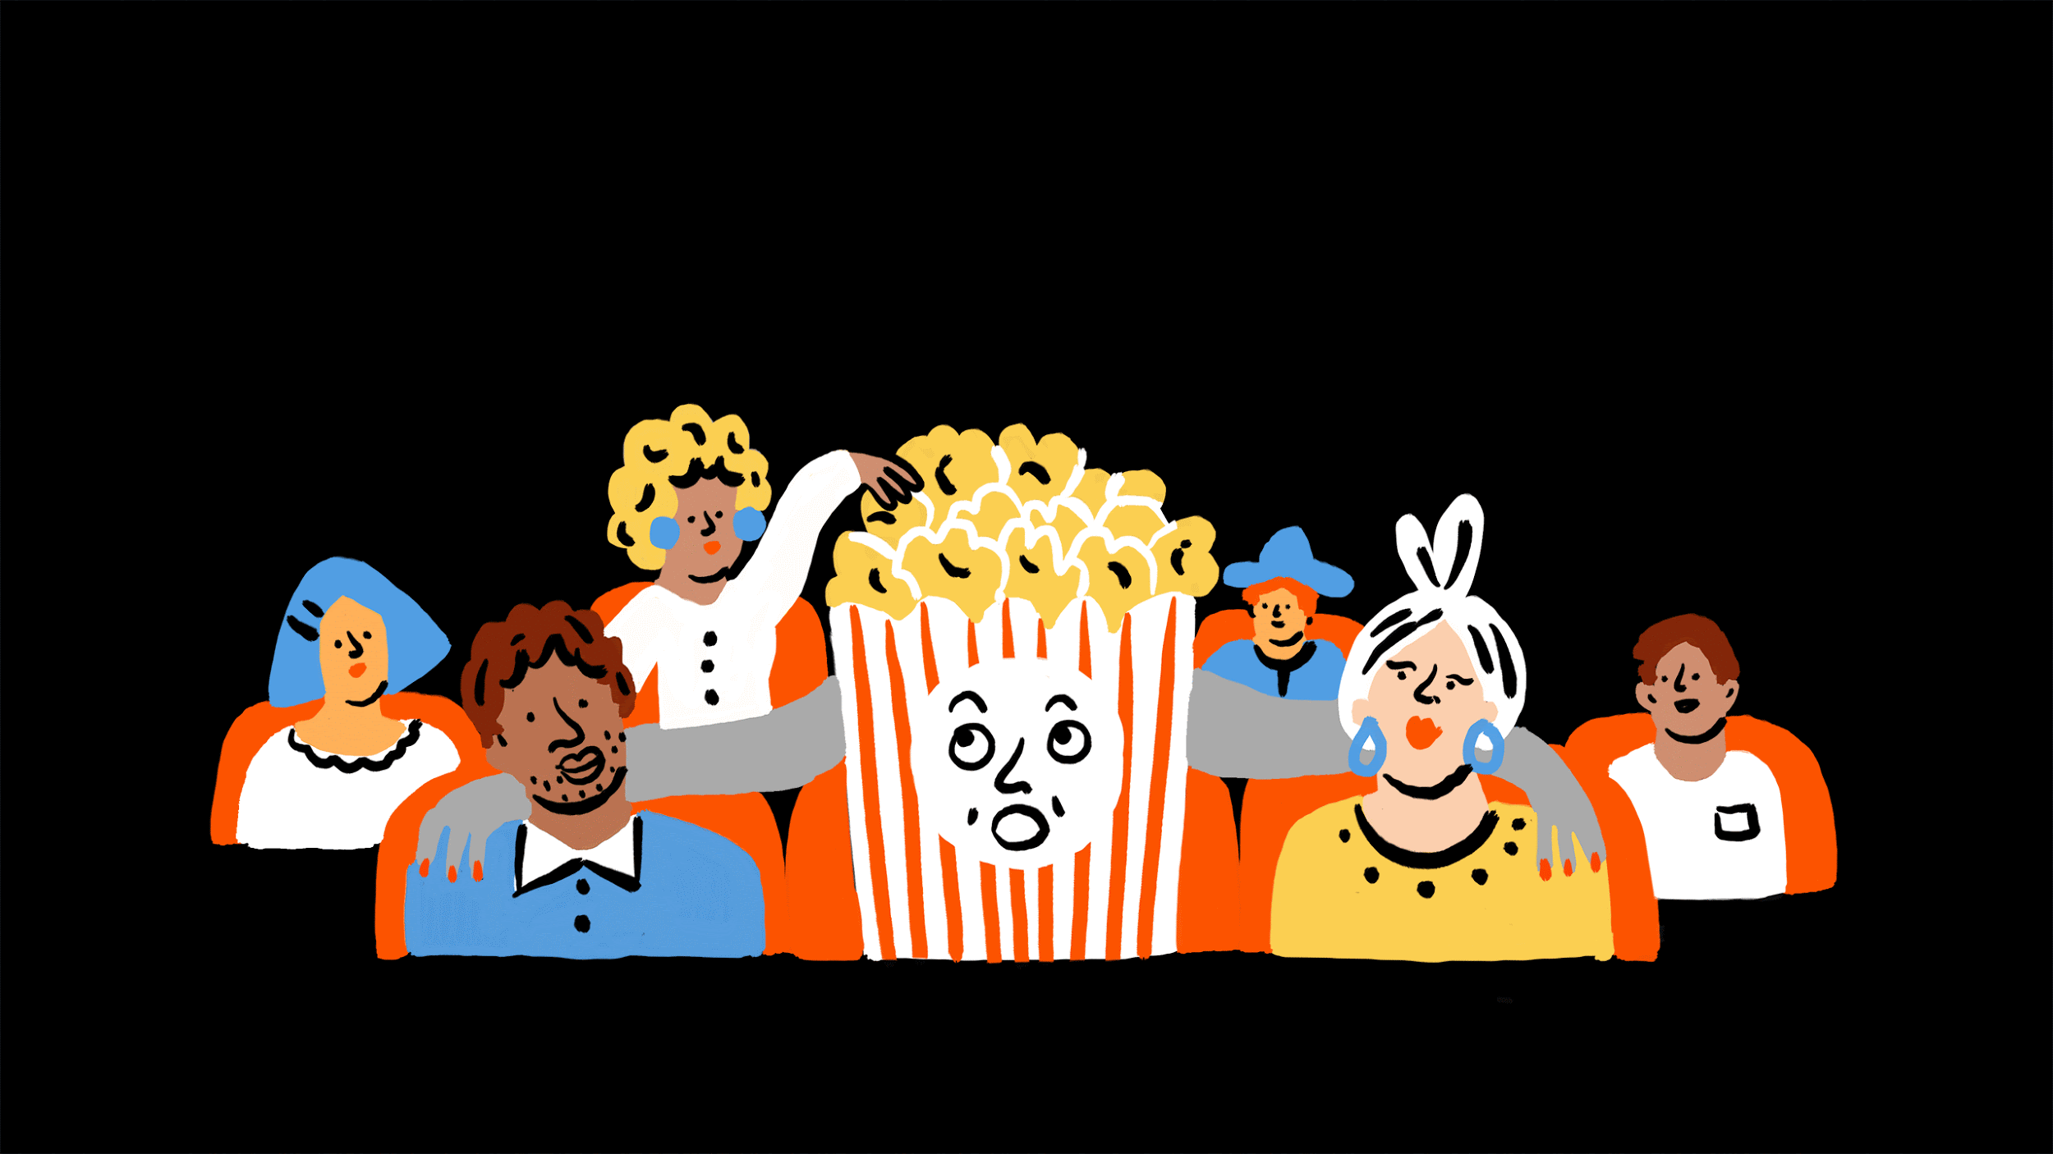
MOVIES ARE A GREAT ESCAPE

Slide 3

HOWEVER, MOVIES ARE NOT A ONE SIZE FIT ALL

Slide 4

HAVE YOU EVER BEEN FORCED TO GO TO A MOVIE YOU HATED?
HAVE YOU SEEN MOVIE ADS ON INSTAGRAM THAT YOU WOULD NEVER WATCH?

Slide 5
Road Map
1.) Experiment Description
2.) Data description and Prescriptive analysis
3.) Result presenting
4.) Application and Recommendation

Slide 6
Experiment Description

Slide 7
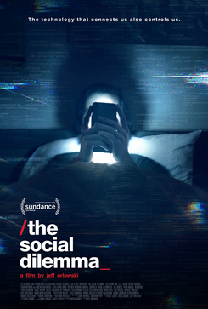
Movie 1: Documentaries

Slide 8

Movie 2: Horror movies

Slide 9

Movie 3: Romantic movies

Slide 10




DATA DESCRIPTION
UserID
Ratings by users for movies 1, 2 and 3
Personality attributes score (1 to 7)
Would you recommend the movie? - Y/N

Slide 11
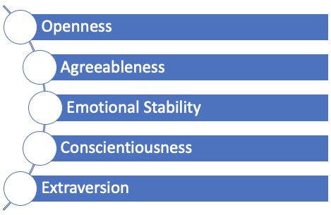
PERSONALITY ATTRIBUTE DEFINITIONS
Notes:
Openness - tendency to prefer new experience
Agreeableness - tendency to be compassionate and cooperative towards others rather than suspicious and antagonistic
Emotional stability - tendency to have psychological stress
Conscientiousness - tendency to be organized, dependable, and self-disciplined
Extraversion - tendency to be outgoing

Slide 12
Data description and
Prescriptive analysis

Slide 13
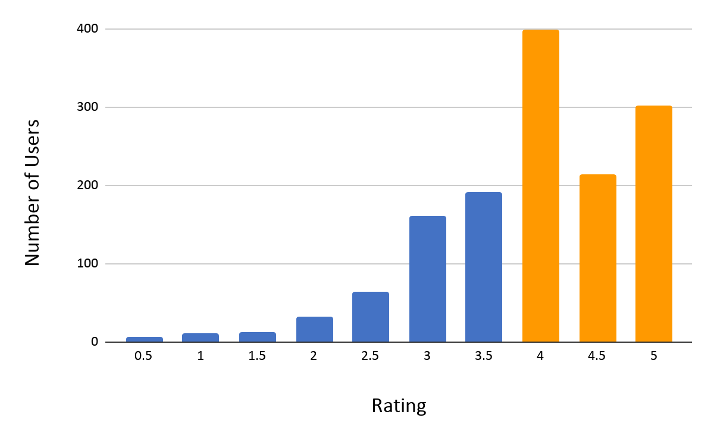
Frequency of the rating for movie 1

Slide 14
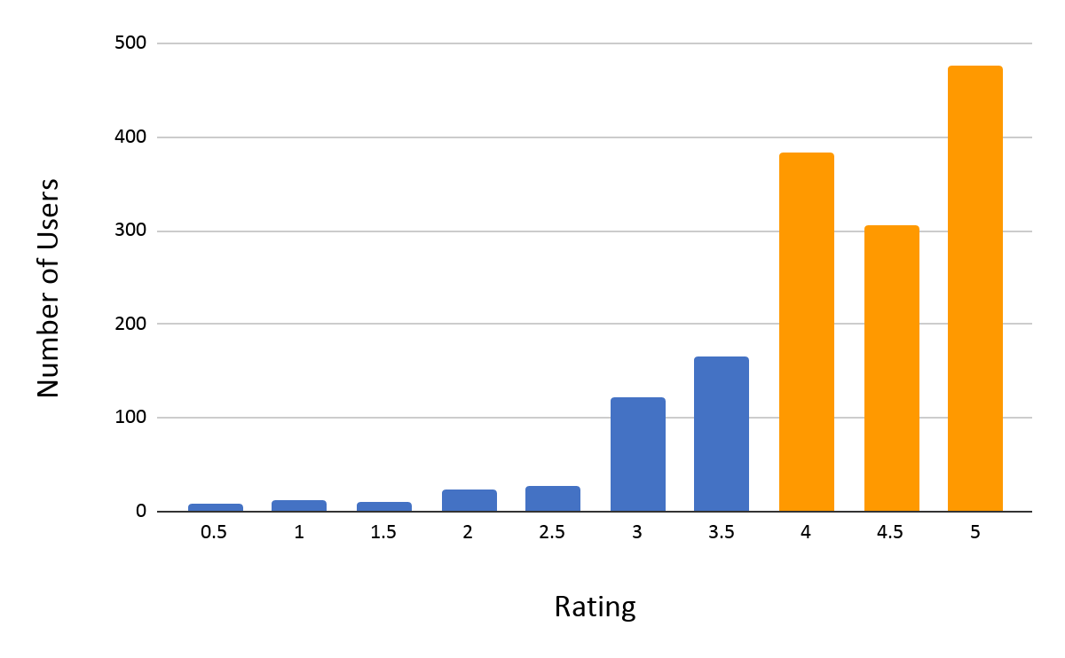
Frequency of the rating for movie 2

Slide 15
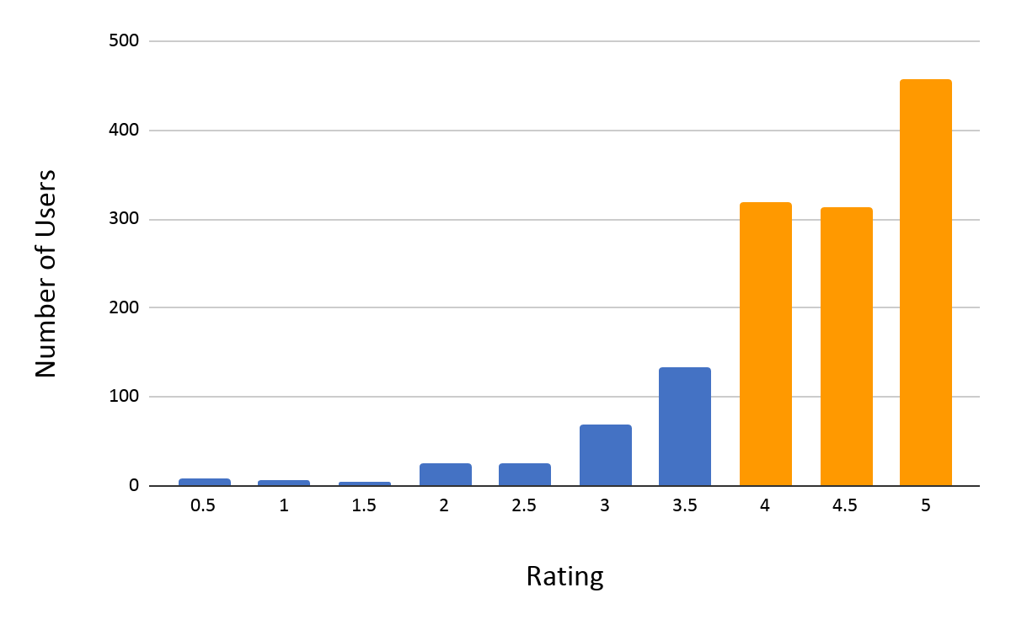
Frequency of the rating for movie 3
Notes:
geneally high

Slide 16
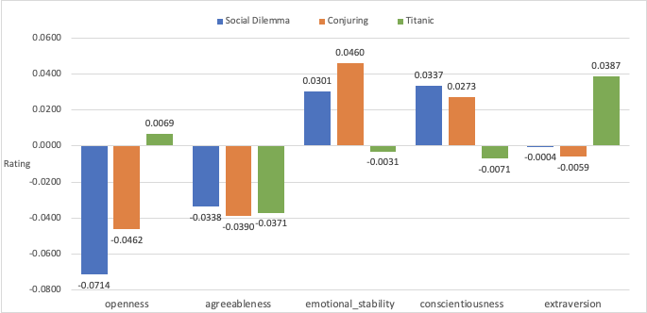
Coefficient result on rating

Slide 17
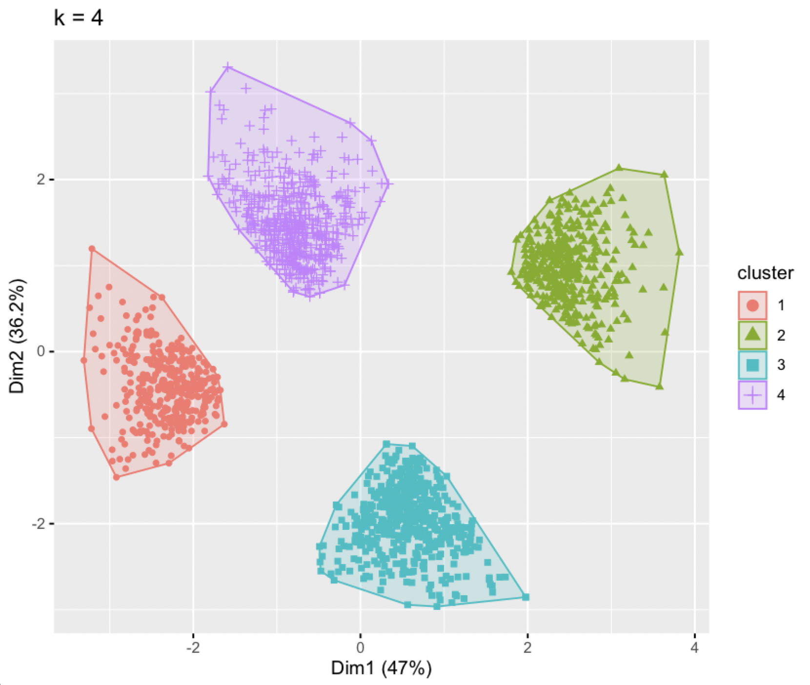
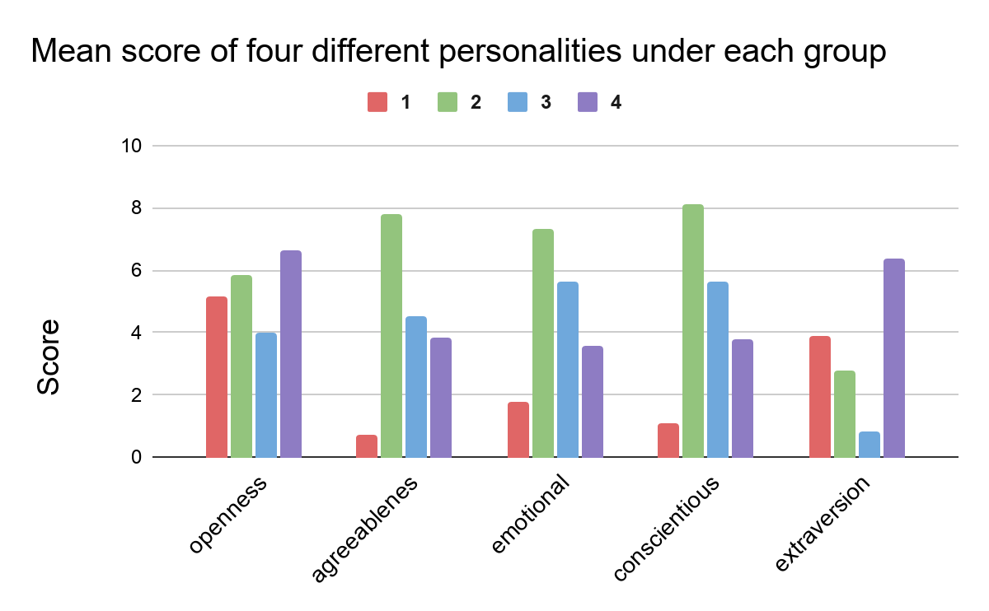
Four groups of movie graders from cluster analysis and their personality score
Notes:
x-axis and y-axis added

Slide 18
Result Explanation

Slide 19

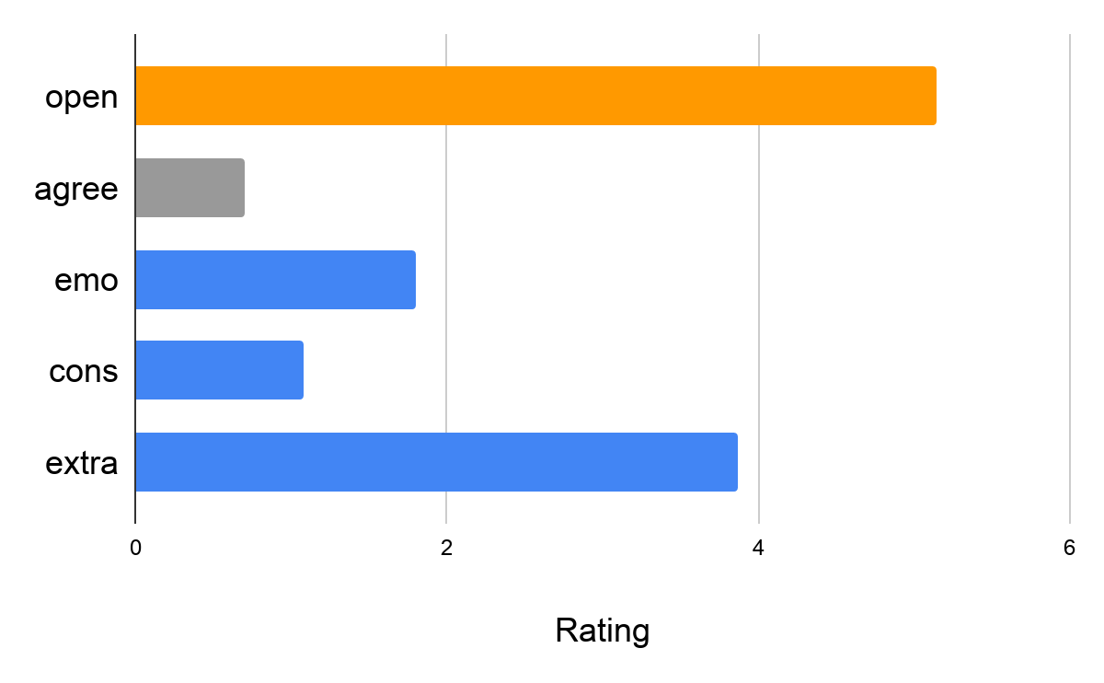
For persona 1
Documentaries: 4.01
Horror movies: 4.28
Romantic movies: 4.11
Notes:
who is an extra person and very willing accept new thing. However, a harsh grader, having a low agreeableness on things. person like professor avery. He tends to like horror movies, and rank Romantic movies the second.

Slide 20

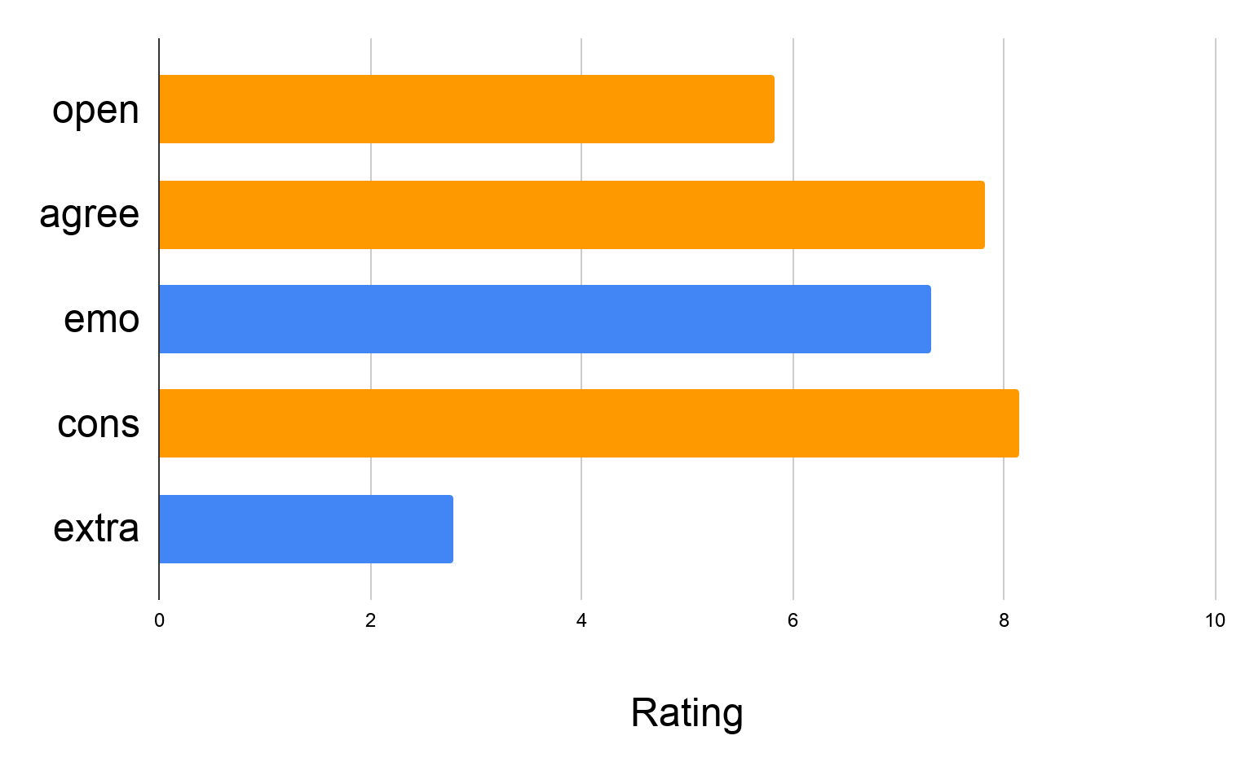
For persona 2
Documentaries: 4.03
Horror movies: 4.30
Romantic movies: 4.10
Notes:
who is well- organised and willing to accept and review new things like

Slide 21

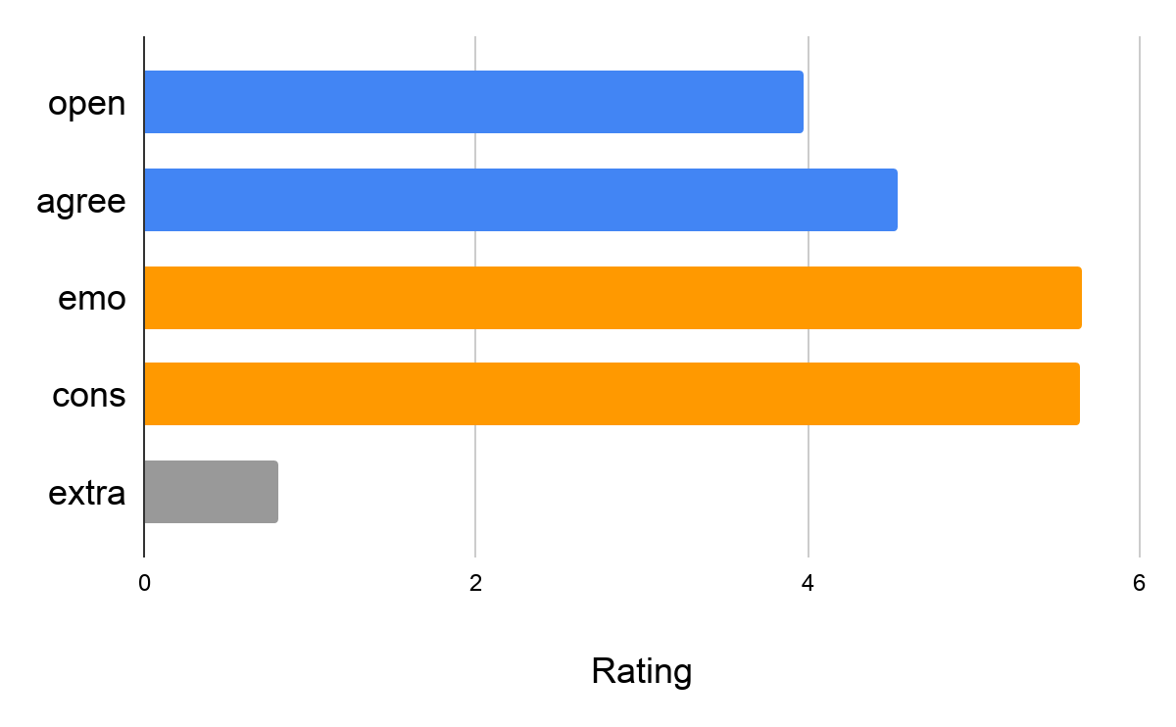
For Persona 3
Documentaries: 4.40
Horror movies: 4.08
Romantic movies:
3.84

Slide 22

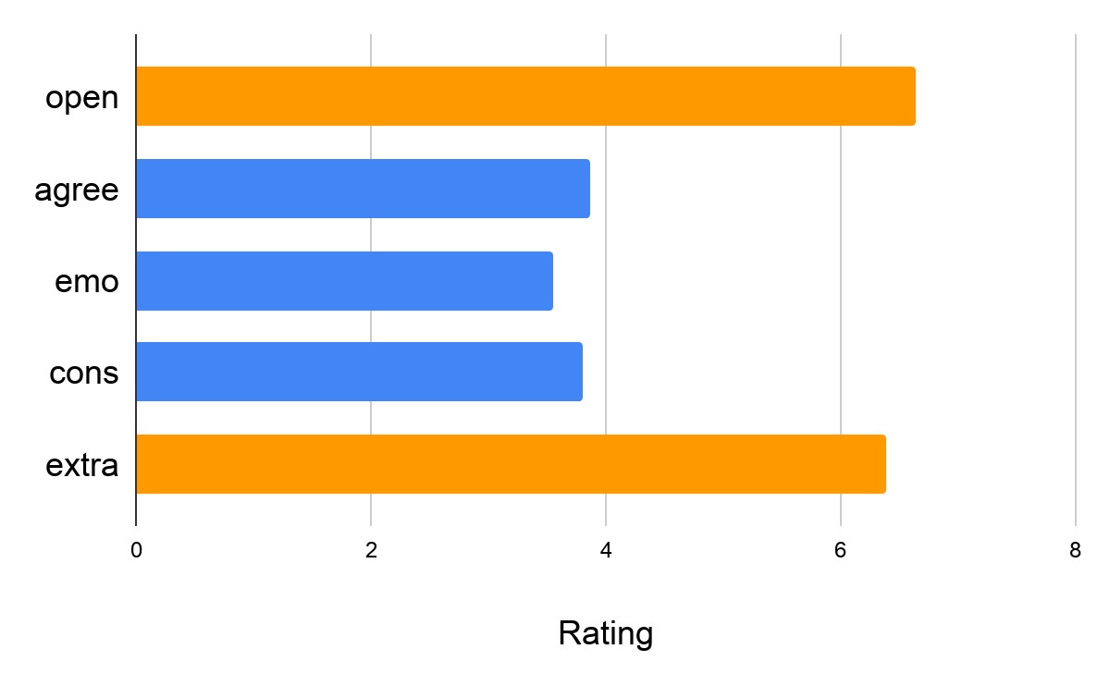
For persona 4
Documentaries: 3.79
Horror movies: 4.08
Romantic movies: 4.41
Notes:
So according to our model and data,
you can categorize yourself, knowing the personality yourself, you can avoid watching movies you don’t like.
And also, for the companies like Netflix and Hulu, which movies a , those data are also very important.

Slide 23
Recommendations and Applications

Slide 24
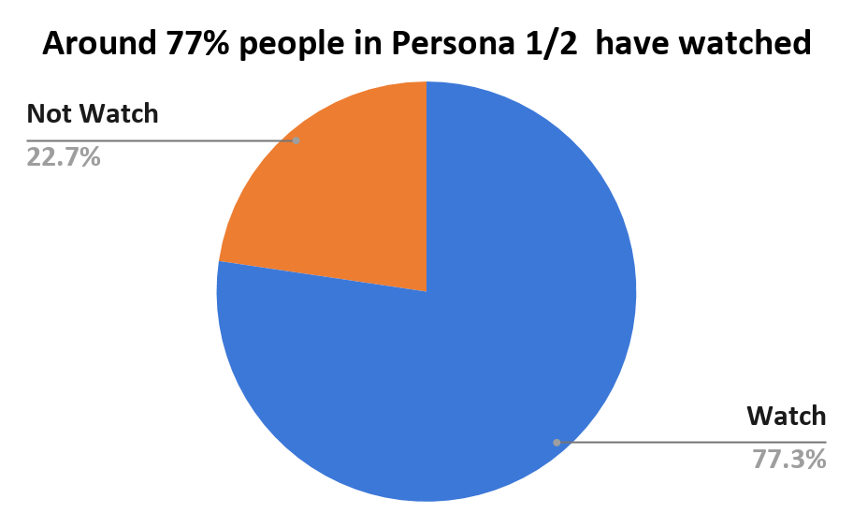

Average rating for SAW inside persona 1/2: 4/4.03
Notes:
what percentage of people will rate higher

Slide 25
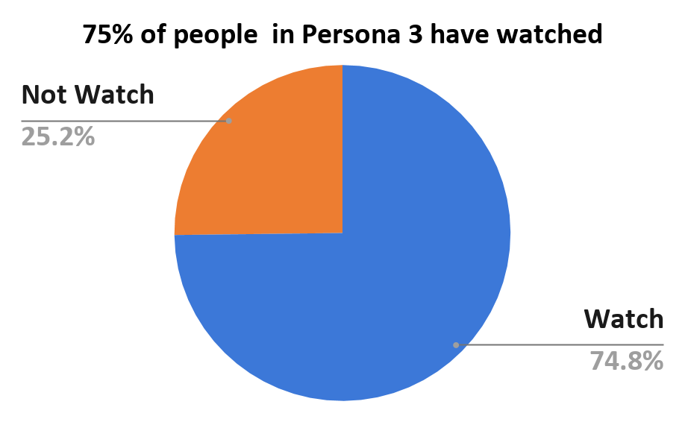
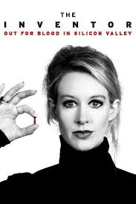
Average rating for inside persona 3: 3.82
Notes:
what percentage of people will rate higher

Slide 26
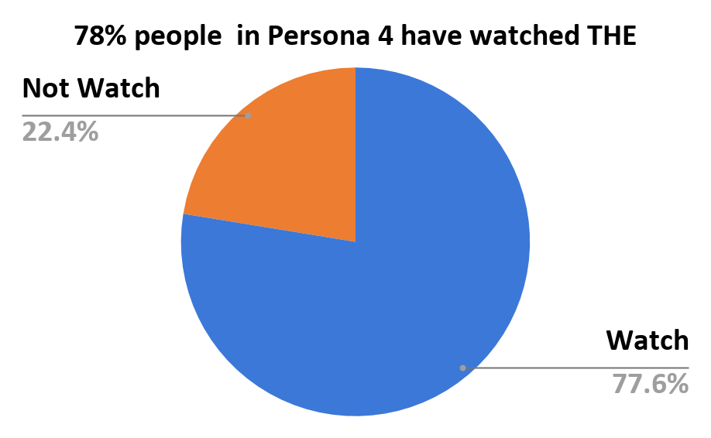

Average rating for inside persona 4: 3.99
Notes:
what percentage of people will rate higher

Slide 27
Recommendations Summary
Users
Persona 1
Persona 2
Persona 3
Persona 4
Horror Movies
Documentary
Romance Movie

